Slide 1
Research Papers
Name
Algorithm Used
Advantages
Disadvantages
Accuracy
Future Scope
Block diagram/Architecture

Slide 2
Social Bot Detection Using "Features Fusion"
Algorithm Used | 1) Latent Dirichlet Allocation (LDA) 2) VADER Sentiment Analysis 3) Feature Fusion 4) Classifiers: The extracted features are input into multiple classifiers including: Linear Regression;Random Forest;AdaBoost
Advantages | -Improved Accuracy: The feature fusion method significantly improves the accuracy of social bot detection, with F1 scores exceeding 0.90 when using AdaBoost. -Incorporates Multiple Feature Types: By combining emotional, topical, and temporal features, the approach captures more subtle patterns that distinguish bots from real users.
Disadvantages | - Complexity: The feature fusion approach is more computationally complex compared to using single features. The combination of multiple features adds overhead, especially when processing large datasets. - Feature Engineering Intensive: The manual feature engineering process, especially when combining features like time, emotion, and topic, can be labor-intensive and may require domain-specific knowledge.
Accuracy | The best results were achieved using the AdaBoost classifier, with an F1 score above 0.90 for the fused features.
Future Scope | - Expanding Feature Fusion: Future research could focus on expanding feature fusion by including more sophisticated features such as network-based features or incorporating more data modalities like images or video. - Real-Time Detection

Slide 3
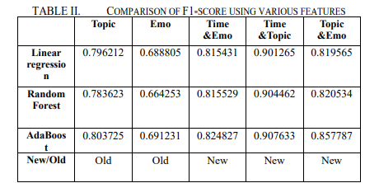
Comparison

Slide 4
SEGCN: a subgraph encoding based graph convolutional network model for social bot detection
Algorithm Used | 1)Graph Convolutional Networks (GCN): GCNs aggregate features from neighboring nodes to update a node's representation. In SEGCN, the focus is on encoding entire subgraphs around a node rather than just the node’s direct neighbors. 2)Subgraph Extraction and Encoding: Random walks are used to extract subgraphs for each node, which are then encoded by the GCN. 3)RoBERTa for Semantic Encoding: The RoBERTa model is used to extract semantic features from the text data (e.g., tweets and user descriptions).
Advantages | - Enhanced Expressive Power: By encoding subgraphs instead of focusing only on direct neighbors, SEGCN captures more complex relationships between nodes, making it more effective in identifying social bots. - Comprehensive Feature Set: The model combines semantic, property, and structural features, which enhances its ability to detect bots that may evade detection by simpler methods focusing on just one type of feature.
Disadvantages | 1. The real-world application of this model may face challenges due to restrictions in accessing data, especially on platforms like Twitter (now X), where much of the necessary user data is no longer freely accessible. 2. Subgraph encoding is more computationally expensive than traditional GCN approaches, which might limit its scalability to very large social networks.
Accuracy | SEGCN was evaluated on two benchmark datasets, TwiBot-20 and TwiBot-22. It achieved superior performance compared to baseline models like GCN, BotRGCN, and SATAR. The F1-score and accuracy were consistently higher, with accuracy improving by 12.4% in some cases.
Future Scope | 1. Future research could explore constructing heterogeneous graphs for social bot detection, incorporating various types of activities and relationships within social networks. 2.The model could be adapted to adjust its features dynamically based on the evolution of bot behaviors, making it more resilient to new types of bots.

Slide 5
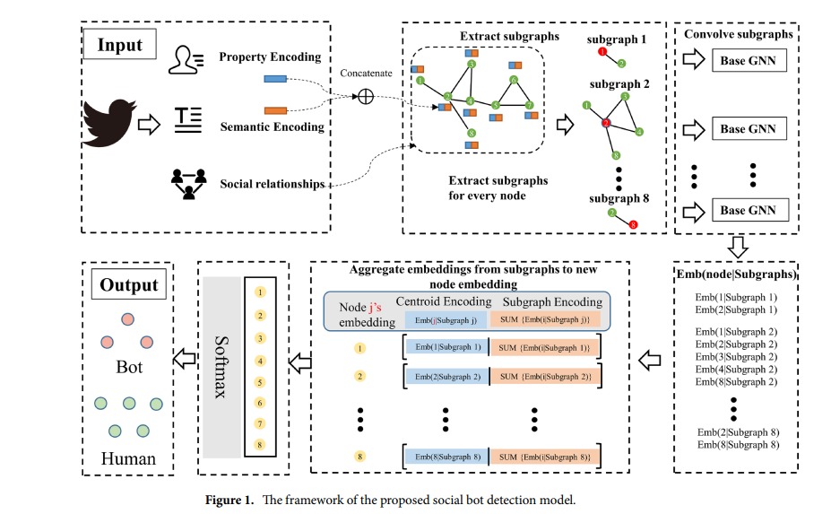
Framework

Slide 6
A New Joint Approach with Temporal and Profile Information for Social Bot Detection
Algorithm Used | 1. BiGRU: Extracts temporal patterns from both the content (semantic features) and metadata of posts. 2. BERT (Bidirectional Encoder Representations from Transformers): Used to capture semantic features from posts. 3. Attention Mechanism: Helps the model focus on the most relevant features during classification.
Advantages | 1. High Accuracy: TPBot achieves an F1 score of 0.9837 on the Sina Weibo dataset, outperforming state-of-the-art baselines. 2. Automatic Feature Extraction: The system bypasses manual feature engineering by using deep learning to automatically extract important patterns from data.
Disadvantages | 1.The use of BiGRU and attention mechanisms makes the model computationally intensive. 2.Data collection from platforms like Twitter may face limitations due to API restrictions, which could impact the model's performance in real-world applications.
Accuracy | The paper compares TPBot with other existing models and demonstrates that it outperforms many state-of-the-art baselines, achieving superior accuracy and precision. The model achieves an F1 score of 0.9837 on the Sina Weibo dataset, which indicates very strong performance.
Future Scope | 1. Optimizing TPBot for real-time detection of social bots will be a key area of future research. This would involve reducing the model's computational overhead, enabling it to detect bots faster and with lower latency in real-world scenarios. 2. Extending the model to incorporate multi-modal data, such as images, videos, and even user behavior analytics (e.g., clicking patterns or browsing behavior), would help in detecting more sophisticated bots that use media-rich content.

Slide 7
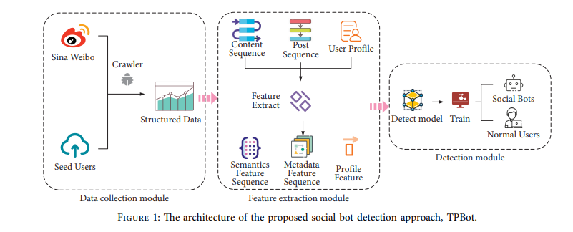
Architecture

Slide 8
SEBD: A Stream Evolving Bot Detection Framework with Application of PAC Learning Approach to Maintain Accuracy and Confidence Levels
Algorithm Used | 1. Graph Attention Networks (GATs): Each node in the social network (such as a user account) is connected to other nodes (followers/following). The attention mechanism assigns different weights to these connections, identifying which relationships are most important for classification. 2. Multi-View Graphs: SEBD uses multi-view graphs, meaning that multiple graphs representing different types of relationships (follower-following, retweet interactions) are processed together. 3. PAC Learning: PAC learning provides a theoretical guarantee that the model will make predictions with high accuracy, given a certain amount of training data. It helps ensure that the model generalizes well to unseen data, which is crucial for real-time bot detection.
Advantages | 1. Real-Time Bot Detection: SEBD is designed for real-time operation, making it highly applicable to live social media platforms where bot activity can happen rapidly. 2. High Accuracy: SEBD achieved an accuracy score of 0.97 and an AUC score of 0.98 using the random forest classifier.
Disadvantages | 1. Complexity: The use of multi-view graphs and GATs increases the computational complexity of the model. This can be a challenge when scaling to larger datasets or more extensive social networks. 2. Data Limitations: The effectiveness of SEBD depends on access to sufficient data streams. Restricted access to social media data (e.g., changes in Twitter’s API) could hinder the model's performance.
Accuracy | High
Future Scope | 1. Enhancement with Concept Drift Handling: Future iterations of SEBD could include concept drift mechanisms to adapt more effectively to changing bot behaviors over time. This could involve using sliding windows or updating the model periodically with new training data. 2. Botnet Detection: The paper suggests future work could focus on detecting bot masters, or the central controllers of botnets, by analyzing the broader structure of the social network.

Slide 9
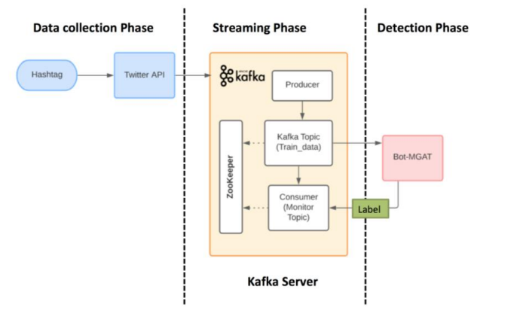

Slide 10
Bot Detection on Social Networks Using Persistent Homology
Algorithm Used | Topological Approach: The method focuses on higher-order interactions between users, providing deeper insights into the network's structure that are often missed by classical methods. Persistent Homology: This helps capture complex structures, such as loops and holes, which are essential to differentiate between bots and humans.
Advantages | 1. Limitations of Classical Methods: Traditional methods only consider pairwise interactions and fail to capture the more complex group-level interactions prevalent in social networks. 2. Persistent Homology’s Advantage: By considering structures like triangles and larger cliques, persistent homology provides a more comprehensive analysis of the network's topology.
Disadvantages | 1. This may limit the scalability of the approach when applied to real-time, large-scale bot detection systems. 2. Data limitations or incomplete network information could impact the model's ability to detect bots accurately.
Accuracy | The paper reports an accuracy of 78.57% in detecting bots on a Twitter dataset. Additionally, the method has a bot recall rate of 86.49%, indicating that it is effective at correctly identifying bot accounts.
Future Scope | The authors suggest extending this method to not only detect bots but also to classify different types of bots (e.g., automated bots, troll accounts). Additionally, future work could involve using other networks on Twitter, like the retweet network or hashtag network, to further refine the model's accuracy.

Slide 11
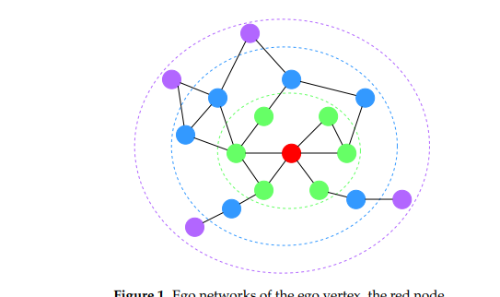
Ego networks of the ego vertex

